Slide 1

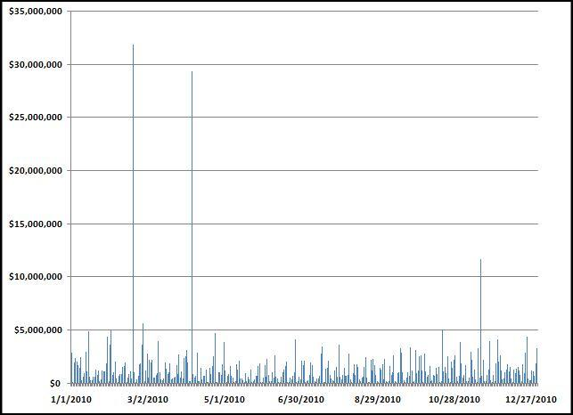
Chapter 10
People don’t know when to stop
Look for largest in a group
Most overtime, most refunds, most travel
Most growth of a subset
Prepared by:
Mark J. Nigrini
Copyright © 2012 by Mark J. Nigrini. All rights reserved.
Notes:
Pages 191 to 211.
When people carry out a fraudulent scheme they don’t know when to stop. The simple test of looking for the largest subsets (overtime, travel reimbursements etc.) or for looking for the largest growth in a subset has produced valuable results.

Slide 2
introduction
Samples of high-risk transactions
A subset is a group of records with something in common
E.g., vendors, customers, locations
Look for largest $$$ or largest growth
Tests can detect fraud or errors
Tests can be run in Access or Excel
Notes:
Pages 191 to 192.
When people carry out a fraudulent scheme they don’t know when to stop. The simple test of looking for the largest subsets (overtime, travel reimbursements etc.) or for looking for the largest growth in a subset has produced valuable results.

Slide 3
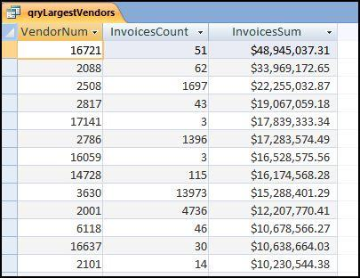
largest vendors
Notes:
Page 192.
Figure 10.1
The largest subsets table in Figure 10.1 shows the vendor number, the invoice count, and the total dollars invoiced by the vendor in 2010. The table shows that the largest vendor (#213709) invoiced 51 times for a total amount of $48,945,037.31. .

Slide 4
findings
35,000 Hewlett-Packard invoices per year
1,300 overtime hours per year
12,000 invoices from a printing shop
100,000 FedEx invoices per month
Excessive refunds
Large negative inventory balances
Two vendors, 100 checks each per month
Notes:
Pages 193 to 195.
Other examples include:
Employee reimbursements with one employee getting $620,000 in a single year. Also, a high amount spent at a vendor for car batteries.

Slide 5
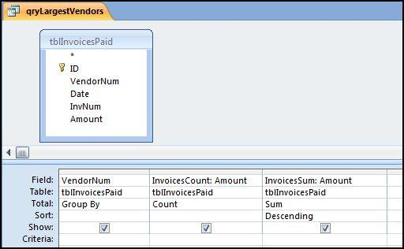
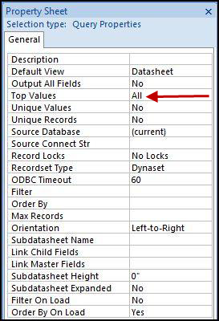
access queries
Notes:
Pages 195 to 197.
Figures 10.2 and 10.3.
The logic in Access is basically to (a) identify the subset field and the numeric field that will be counted and summed, (b) to use the Group By, Count, and Sum functions to identify the largest subsets, and (c) to sort by Sum or Count descending. Running the basic version of this test in Access is reasonably straightforward. Adding some bells and whistles require some design grid gymnastics.

Slide 6
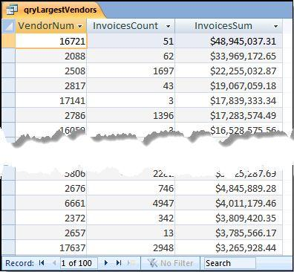
Top 100 vendors
Notes:
Page 197.
Figure 10.4.
The results are limited to the 100 largest vendors in Figure 10.4. The results are easier to interpret when the output includes vendor names. A recent analysis of purchasing card data included a restaurant on a largest subsets list for $31,000. While the total dollars were not particularly high, the fact that it was small hole-in-the-wall restaurant next to a factory raised more than just a few eyebrows. The auditor knew that this was not an eatery used to conduct company business. It was more a lunch time eatery for employees.

Slide 7
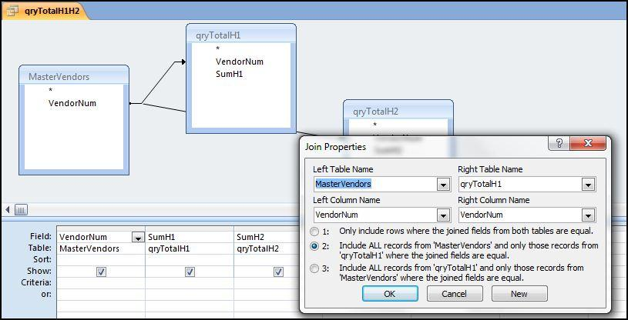
largest growth
Notes:
Pages 197 to 200.
Figure 10.7.
This test identifies cases where a subset had a growth spurt over some period of time. This growth spurt could be due to fraud, error, or simply a change in circumstances. A purchasing card holder might have new job responsibilities requiring more travel than before.
For the largest growth test we will use the invoices data and the comparison will be between the totals for each vendor for the first half and the second half of the year.
To get the H1 and H2 totals for each vendor side-by-side we need to set up a query as is shown in Figure 10-07 with a left outer join.

Slide 8
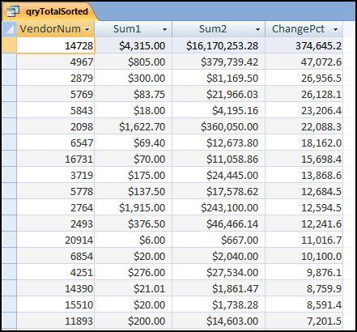
largest growth results
Notes:
Page 202.
Figure 10.9.
This largest growth result needs to be carefully studied. We are interested in large percentage increases, but not necessarily when the base is small. For example, and increase from $6.00 to $667.00 is an 11,017 percent increase, but the base is small. However, in this case it is a possibility that the second period amount was really for $6.67 (which sounds like a better match to $6.00) and the amount was incorrectly entered as $667.00 and not $6.67.

Slide 9
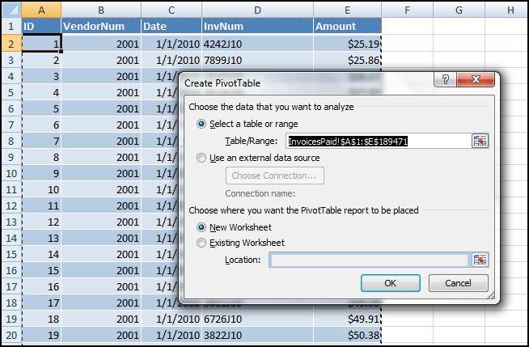
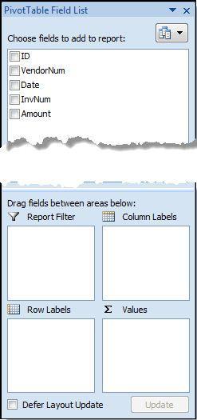
excel: largest subsets
Notes:
Pages 200 to 205.
Figures 10.11 and 10.12.
Use the pivot table function using Insert→Tables→Pivot Table→Pivot Table. This will give the dialog box shown in Figure 10.11.
The next step is to configure the pivot table. The first configuration step is to drag the field VendorNum to the Row Labels box and Amount to the Sum Values (∑ Values) box. The subsets and their sums are shown in columns A and B. These results now need to be sorted by Amount descending and the SumOfAmount field needs to be formatted as currency with two decimal places. To run the sort command use Home→Editing→Sort&Filter with the cursor in cell B4. The tidying up steps include closing the pivot table dialog box and deleting the top two rows.

Slide 10
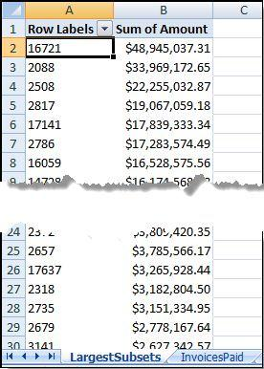
excel: results
Notes:
Pages 200 to 205.
Figure 10.13.
The largest subsets Excel result agrees with the Access result in Figure 10-04. The last row of the Excel output (row 26168) shows the grand total and this grand total agrees with the data profile total in Figure 4.1. Excel's pivot tables are a very useful tool for forensic analytics.

Slide 11
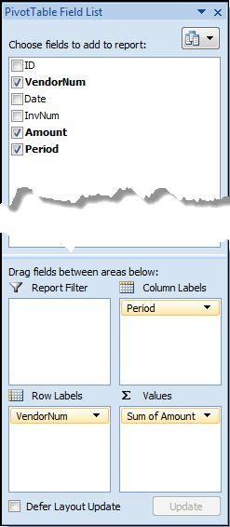
excel: largest growth
Notes:
Pages 203 to 210.
Figure 10.15.
We need to use an indicator variable to indicate whether the invoice belongs to H1 (the first half of the period) or H2 (the second half of the period). This is done using the IF function and the function and the result is shown in Figure 10.14 (not on this slide).
=IF(MONTH(C2)<=6,1,2)
The pivot table is created using Insert→Tables→Pivot Table→Pivot Table. The default settings are usually appropriate for the largest subsets test or the largest growth test. Click OK to activate the pivot table dialog box. The pivot table is then set up as is shown in Figure 10.15.

Slide 12
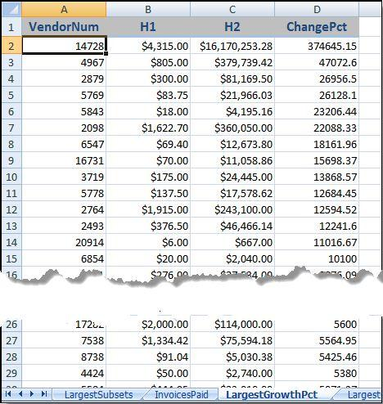
excel: results (%)
Notes:
Page 208.
Figure 10.17.
The subsets with the largest percentage growth numbers are shown in Figure 10.17. For the subsets growth test we are interested in subsets that have a large percentage growth and also subsets that have a large growth measured in dollars.

Slide 13
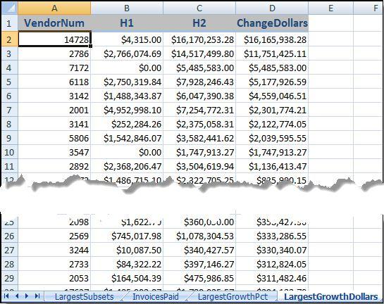
excel: results ($)
Notes:
Page 208.
Figures 10.18.
The step to convert the changes to dollars and to sort the results descending requires changing the formula in column D and then sorting the data from largest to smallest. Creating a copy of the worksheet means that both sets of results are easily accessible. The results are shown in Figure 10.18.

Slide 14
Using dates as the subset
Notes:
Pages 209 to 210.
Figure 10.20.
As a final test in the series the data will be analyzed using dates as the subset variable. The test is especially useful for purchasing card irregularities and prior work has found excessive purchases at or near the end of the fiscal year and also excessive purchases around the holiday season.

Slide 15
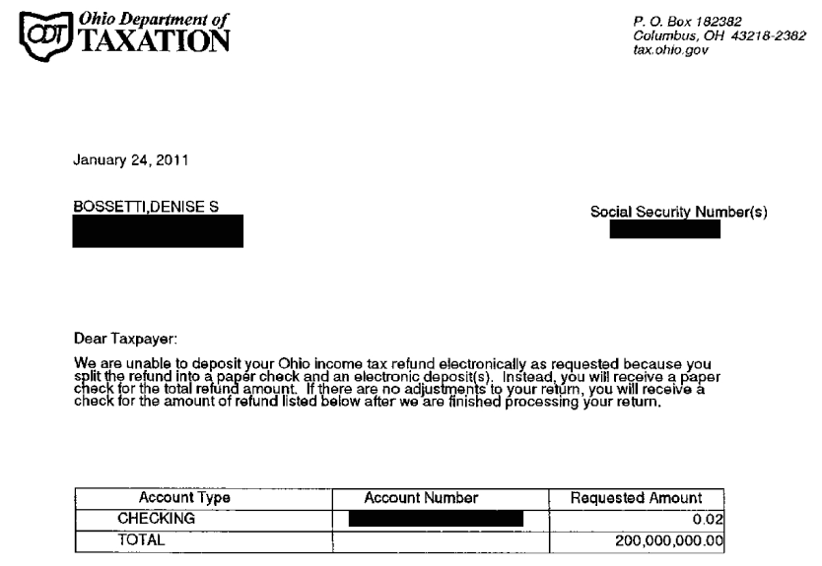
example of a large error
Notes:
Not in the book.
A Google search for “Woman gets $200 million tax-return notice — but it was mistake“ will give the Sandusky Register details of this story.

Slide 16
summary
Can be innovative in choice of subset variable
People don’t know when to stop once they have figured out how to cheat the system
Test can detect frauds and errors
Tests can point to efficiency gains
Largest subsets: Access or Excel (pivot tables)
Largest growth: Easier in Excel
Results should be carefully interpreted
Notes:
Pages 210 and 211, and a review of the main points in the chapter.
Results should be carefully interpreted. This refers to the auditor that realized that the restaurant was a hole-in-the wall right next to the factory.

